Slide 1
Chapter 6 On Page Optimazation
By:Umer Farooq

Slide 2
On-page SEO
On-page SEO (or on-site SEO) is the practice of optimizing web pages for specific keywords in order to improve search visibility and traffic. It involves aligning page-specific elements like title tags, headings, content, and internal links with keywords.

Slide 3
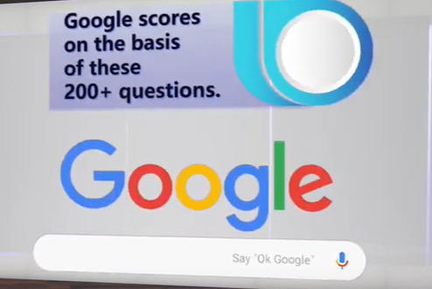
These question ask by google
Than allocate a score
Whose is high its website rank high
Questions can be
Website content
Website hosting
Website languages
Website domain

Slide 4
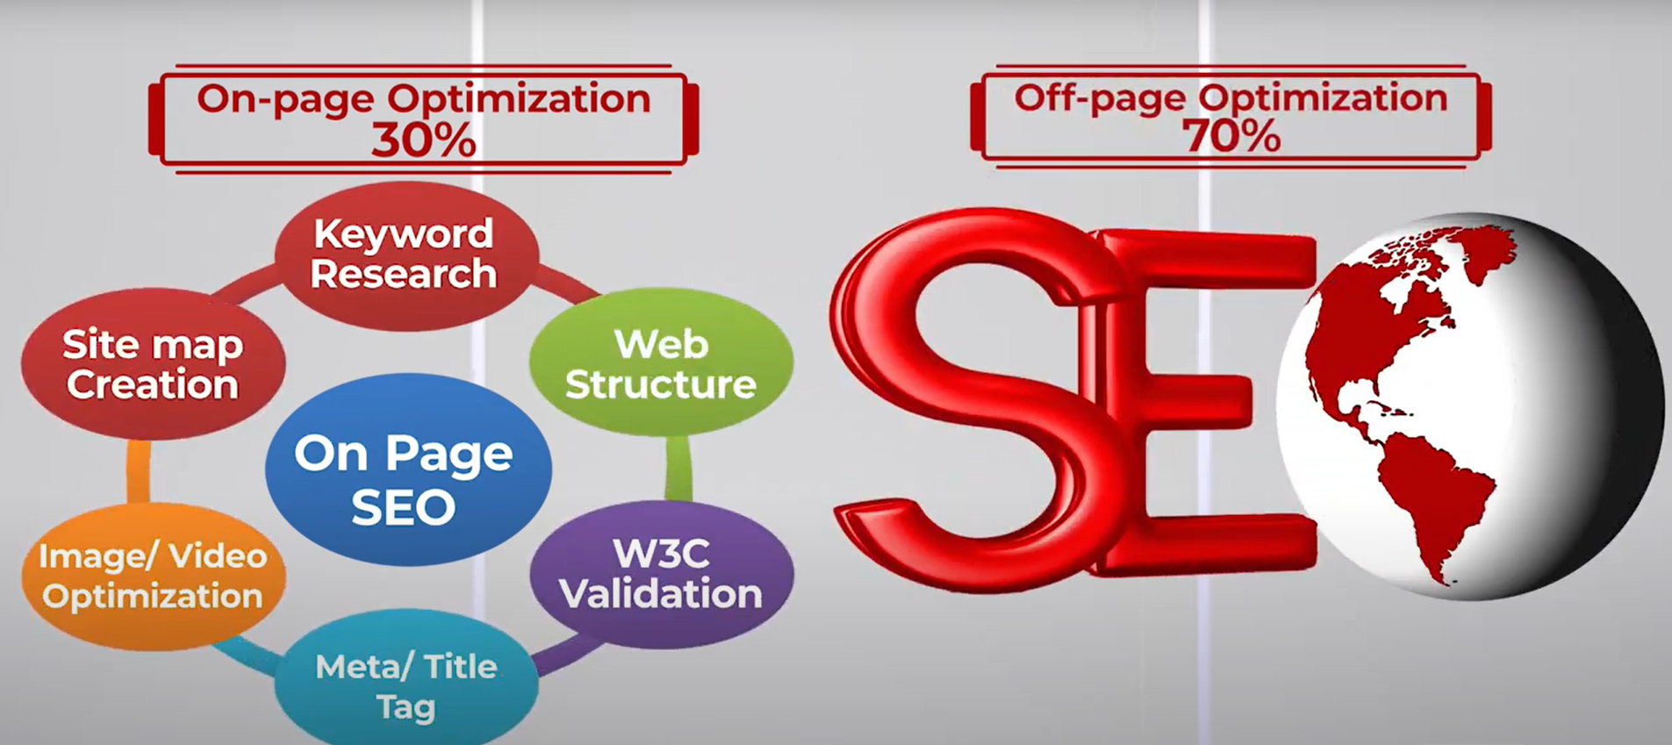
On-page optimazation

Slide 5
Whats included in on-page?
It is related to your website
On page divided into 6 factors
Page level
Image
Site Level Factors
Advanced content
Domain factor
Advanced factors

Slide 6
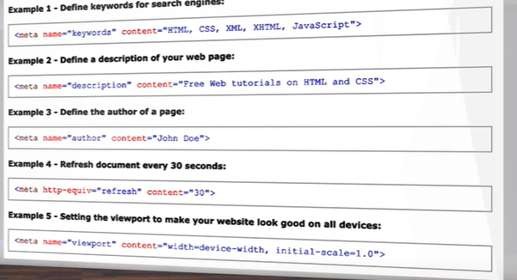
Page Level Factors
Meta tag gives information to browser
It helps to ranking factors
The important tag is title tag
Meta in Description tag limit is
300 but google show 156 character
Keywords tag discontinued by google

Slide 7
Content with Shortlisted Keywords
Static website remain same
But blogs website is dynamic

Slide 8
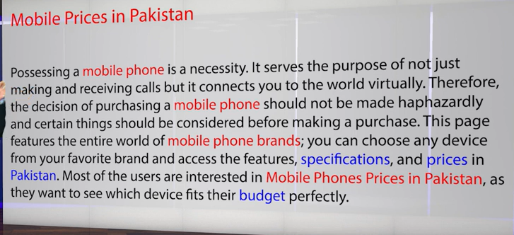

Optimize Content
Red Colors Are Keyword
You should use synonyms
Ex store -> market
Keyword Density must be redundant to 3%
http://www.seobook.com/

Slide 9
Page-Level Factors:
Content length must be more than 500 characters
Heading Also mater in content Content Headings (H1-H6)
You can make content on heading
Content should be divided into section
You can make list, heading and add images for big content
Also make table of content so user directly read its main work

Slide 10
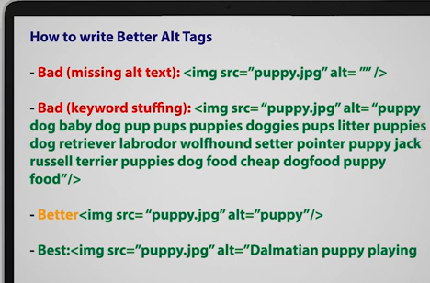
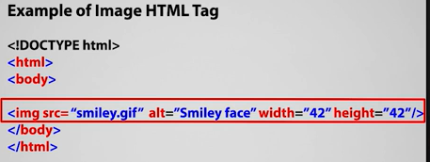
Image SEO:
Image SEO is so important
To enhance content should use SEO ex people watch images before purchasing
Alt tag keyword long keyword
Title , file name also matters
If the image is important it should be on top of content
Image size must less than 100kb for optimize image (you can use photoshop) for optimizing or also use resizeimage.net or any from google

Slide 11
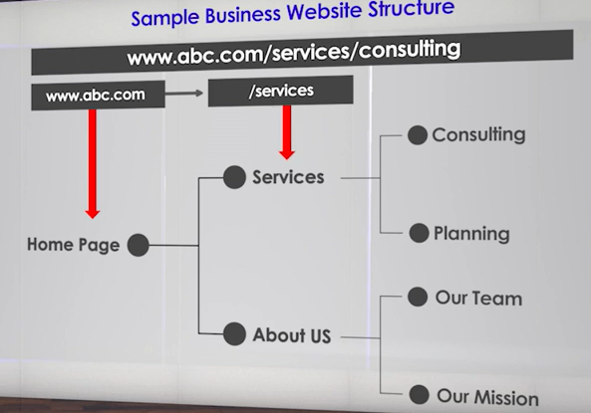
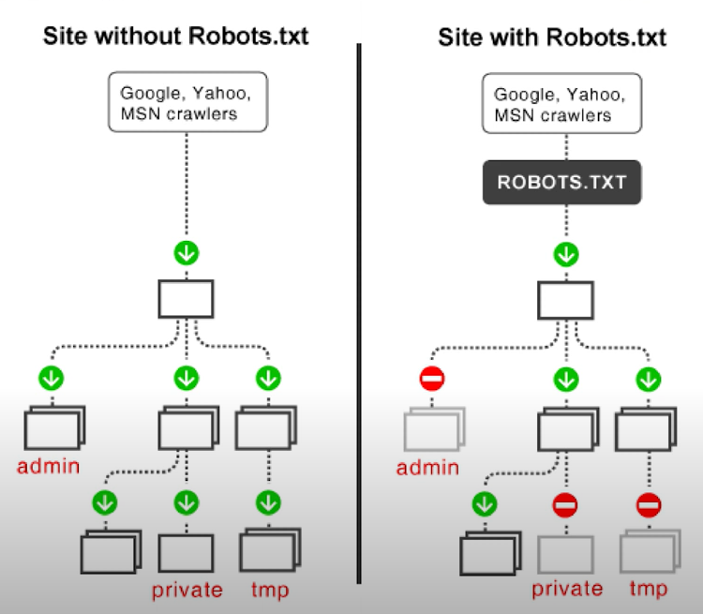
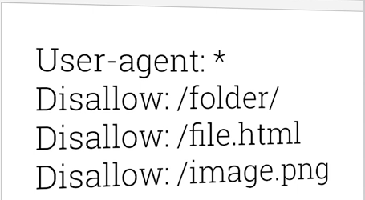
SITE-LEVEL Factors:
Website structure depends on 3 things
Website organized
Max level 4
Organized similar pages together
Url Also human friendly
Internal linking of all pages (same website)
Website UpTime:- Website must be run not to be down for this you can visit uptrends.com
Security:-it is a also a ranking factor
External Links:- other website, but that website must be good if its bad website google think you are promoting that website and palatalized you
Robots.txt:- to avoid particular pages but if any command makes wrong it can make issue to all website

Slide 12
Advanced Content Optimization
Frequent update content
Update data frequently
Blog vs static page
Blog updated and static remain same
Content Duplication
Fixing content through htaccess on domain
Use canonical tag

Slide 13
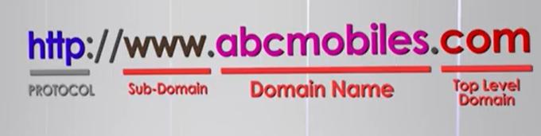
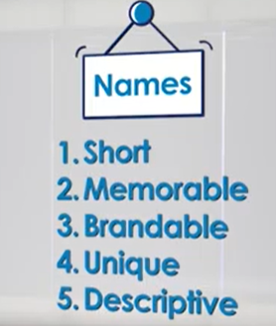
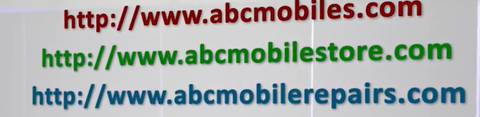
Domain Factors
Domain name
Tld
Top level domain (.com)
Sub Domain
Local or Country TLD Extension
Local domain help in ranking
Keywords in the Domain
Domain Age, Ownership and History
Age ,history also major factor
You are a real person

Slide 14
Advanced On-page Optimization Factors
Better Website Layout & User Experience
Bounce rate : person open website and leave it
if the bounce rate is high google can penalized you
By making good website you can overcome it
Page Loading Speed
Slow speed website penaltized by google
Mobile Friendly Website
Secure your Site with HTTPS
Difference between http and https

